Slide 1
Leveraging Power BI for Ecommerce Sales.
Transforming Data into Decisions
KUMAR DIVYANSHU

Slide 2

Introduction to Power BI
Power Bi is a business intelligence tool develop by Microsoft. It is simple Drag and Drop to approach to visualize , Analyze the Data and Create a beautiful Visualizations.
Power BI is a powerful Market leading, Data Visualization, Data Cleaning , Data Modeling and Business Intelligence Software.
Power BI is a Collection of Components.

Slide 3
The Importance of ECOMMERCE SALES Dashboards
Dashboards simplify complex sales data into clear visuals for easy access, empowering stakeholders to effortlessly grasp essential insights and make informed decisions.
By comprehending customer preferences and purchasing behaviors, businesses can craft personalized marketing strategies and deliver improved customer experiences, fostering loyalty and driving growth in a competitive market.
Continuous monitoring of sales trends, revenue, and customer behavior through dashboards enables businesses to pinpoint areas for improvement, optimizing strategies and enhancing overall performance in the ecommerce landscape.

Slide 4
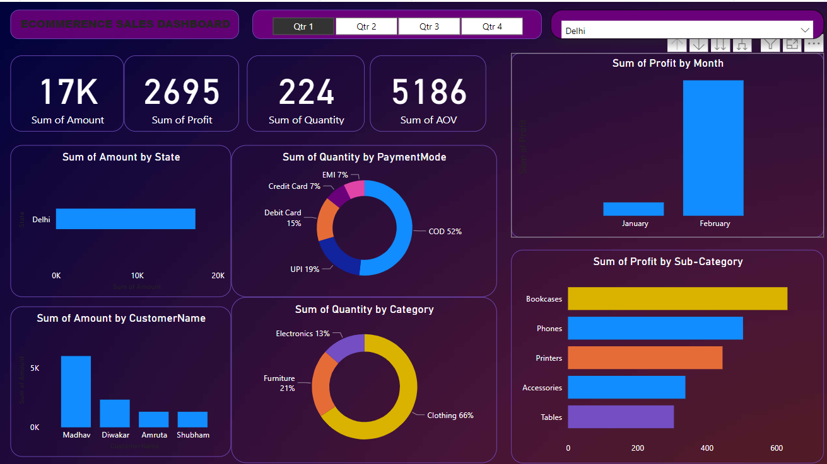
ECOMMERCE SALES DASHBOARD

Slide 5
Objective
Created interactive dashboard to track and analyze online sales data.
Used complex parameters to drill down in worksheet and customization using filters and slicers.
Created connections, join new tables, calculations to manipulate data and enable user driven parameters for visualizations.
Used different types of customized visualization (bar chart, pie chart, donut chart, clustered bar chart, scatter chart, line chart, area chart, map, slicers, etc).

Slide 6
Take Your Business to the Next Level !
The potential of data with Power BI today. This powerful tool empowers organizations to transform raw data into actionable insights. With user-friendly dashboards and robust analytics, Power BI enables informed decision-making, improved efficiency, and a competitive edge.
Its versatility spans various industries, offering customizable reports, real-time data updates, and seamless integration with other Microsoft tools. Don't miss out on the benefits of data-driven decision-making—start using Power BI now to unlock your business's full potential.

